Slide 1

EXPECT TO SUCCEED
Presenter: Ann Marie Walter-Allen, Chief Officer Credit

Slide 2

100% Government Owned
…but Independently financed
Managed by a Board of Directors experienced in many fields from both the private and public sectors

Slide 3
EXIM’s 2020 Vision
To facilitate Jamaica becoming a net exporting country by being a visionary, innovative and creative trade financing institution

Slide 4
Our Focus
EXPORTERS
POTENTIAL EXPORTERS
LINKAGE COMPANIES
Focus on the viability of the Business

Slide 5
Target Sectors
  Agro-Processing
  Aqua-Culture
  Manufacturing
  Tourism
  Mining
  Services
  Creative Industries
  ICT
  …and their Linkages

Slide 6
Working Capital
Equipment Acquisition
Technical consulting
Modernisation of Facilities
Receivables financing
Debt Refinancing*
Market Research
Pre & Post Shipment Discounting
*Note: For the Tourism Sector only. Conditions apply
Use of Funds

Slide 7


Slide 8
Interest Rates
10% pa JA$ Loans
7.5 – 9.0% pa US$ loans
…On the reducing Balance
11% pa JA$ Loans – AFIs

Slide 9
SME Growth Initiative
JMA/JEA Facility
Pre & Post Shipment
Modernisation Fund for Exporters/Tourism
Foreign Currency Lines of Credit
Cuban Line of Credit
Trading House Co-Pack Facility
Loan Offerings

Slide 10
SME Growth Initiative
Interest Rates: 10% p.a.
Loan Ceiling: JS$ equivalent US$500,000
Size of Entity: Net < JA$ 100 million,
Annual Sales < JA$360 million
Target: Productive Sector
Collateral: A Mix
Loan Purpose:
Working Capital, Equipment Acquisition,
Purchase of Raw Material

Slide 11
JEA/JMA Loan Programme
J$2million Loan Ceiling
Working Capital Support
Light Equipment
Eligible borrowers:
Linkage Companies to the Export Sector
<50 permanent employees
Export Ready
Have excess capacity

Slide 12
Modernisation Fund
Interest Rates: 8 – 10% p.a.
Loan Ceiling: No limit
Target: Exporters including Tourism
Collateral: A Mix
Loan Purpose:
Working Capital, Capital Equipment Acquisition,
Refurbishing, Purchase of Raw Material, Technical Assistance, Debt Refinancing (50% of loan amt), any other purpose deemed acceptable

Slide 13
Bankers Export Credit Insurance
Pre Shipment Financing
Max 90 days
Up to 100% of FOB value of your export order
Post Shipment Financing
Max 120 days
Up to 100% of CIF value of your export
Notes:
BECF offers pre and post shipment financing. To be eligible you must be a Jamaican exporter of non-traditional goods which are produced in Jamaica. Goods that are re-packaged for export are not eligible, neither are traditional goods such as sugar, bananas, bauxite and alumina.
For preshipments, finanancing is up to 90 days and it covers up to 100% of FOB export value.
Post Shipment financing goes up to 120 days, and covers 100% of CIF value of your export order.

Slide 14
Trade Credit Insurance
Protects your business against
non-payment of receivables
by local or foreign buyers.
Claim for up to 85% of the value of your receivables – for non payments and for payments over 120 days

Slide 15
TCI Coverage
Foreign & Domestic Receivables
Commercial & Political Risk
Risk Coverage – 85% & 90%
Coverage available to all entities
registered in Jamaica

Slide 16

Trade Credit Insurance
Eligible Transactions
Export Sales of goods & Services
3rd Country sale of goods originating outside Jamaica on behalf of Jamaican firms
Sale of goods only supplied by Jamaican subsidiary companies operating in CARICOM
Goods trans-shipped from Jamaica’s duty-free zones to countries in the Caribbean

Slide 17
Foreign Currency Lines of Credit
Bladex (up to 120 days) 7.50%
Bank of NY (180 days) 5.0 %
Notes:
We

Slide 18
Approved Financial Intermediaries
BNS
Capital & Credit Merchant Bank
Citibank NA
Scotia DBG
First Global Bank
FirstCaribbean Int’l Bank
JMMB
JN Fund Managers
MF&G Trust & Finance
NCB
Pan Caribbean Bank
RBTT
Guardian Asset Management
Sterling Asset Management
Development Bank of Jamaica
Notes:
These are the 15 or so commercial banks, merchant banks, money market institutions and development banks with whom you are probably already affiliated. You are able to access our small business loans through any of these institutions across the island. Just tell them that you would like an EXIM Bank Small Business loan and they should all be geared to assist you. If you experience any problems..or simply if you prefer to do so, you may also approach EXIM Bank directly.

Slide 19
www.eximbankja.com
Application Forms available on-line
The Dorchester Building, 11 Oxford Road,
entrance on Norwood Road Kingston 5
Telephone: 960-9690
Notes:
How to apply
Directly from the EXIM Bank
Through AFIs
Website
There is much more that the Bank has to offer. Please visit our website for more information. You can even download application forms , which you can fill in and bring to our office at 11 Oxford Road.

Slide 20

Notes:
There is much more that the Bank has to offer. Please visit our website for more information. You can even download application forms , which you can fill in and bring to our office at 11 Oxford Road.

Slide 21
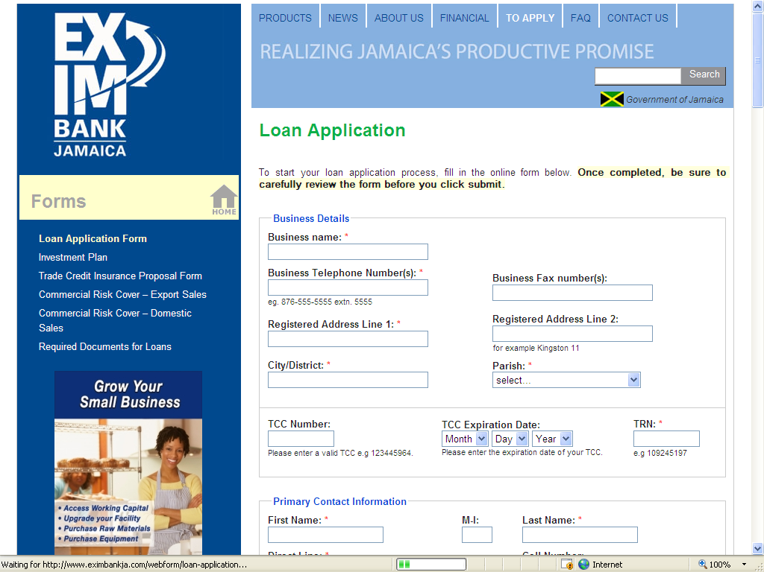

Slide 22

Thank You

